Slide 1
PhonePe - Digital Payments Transaction & Demographic Analysis
- A Case Study by Anik Chakraborty

Slide 2
🎯 Objective
Project Purpose:
To analyze India’s Digital Payments Growth & User Adoption Trends (2018 Q1 – 2021 Q2) using PhonePe transaction and demographic data.
Key KPIs:
Total Transaction Value: 35.63T
Total Transaction Count: 21bn
Average Transaction Value: 1.74K
Total Registered Users: 2bn
Top 10 States by Registered Users
Top 10 Device Brands
Deliverables:
2-page Interactive Power BI Dashboard
Transaction Trend Analysis
Demographic & Device-Level Insights
State-wise Adoption Breakdown

Slide 3
📘 Project Overview
Context Highlights:
Strong quarterly growth in digital transactions
Rapid adoption of Peer-to-Peer & Merchant Payments
Increasing smartphone penetration driving adoption
Expansion across 36 States & UTs and 723 Districts
This project evaluates:
Growth trajectory of transaction value
Category contribution share
Geographic concentration
Device ecosystem dominance

Slide 4
🗂️ Data Overview & Schema
Data Source:
Source: PhonePe Pulse Public Dataset
Data Type: Structured Transactional & Demographic Data
Time Period: 2018 Q1 – 2021 Q2
Data Structure & Metrics:
Key Index Types:
Year, Quarter
State & UT, District
Transaction Type
Device Brand
Population Bucket
Categories:
Peer-to-peer payments, Merchant payments, Recharge & bill payments, Financial Services
Others
Calculated Metrics:
Total Transaction Value (SUM)
Total Transaction Count (SUM)
Average Transaction Value
Total Registered Users
Top 10 Ranking (States & Device Brands)

Slide 5
💻 Tech Stack
Tools:
Excel
Data storage & preprocessing
Python
Pandas, NumPy, Matplotlib
Jupyter Notebook
Data cleaning, EDA & visual analysis
PowerQuery
ETL transformations
PowerBI
Dashboard & Visualization
Data Modeling & Relationship Building
DAX – KPI Calculations Columns & Measures
Slicers & Dynamic Filtering
PowerPoint
Presentation and final dashboard snapshots

Slide 6
📈 Methodology & Analysis
Preparation, Process & Analytical Approach:
Data Preparation & Cleaning:
Standardized naming conventions
Structured Year-Quarter format
Removed inconsistencies
Data Modeling & Integration:
Built relational model between transaction & demographic tables
Time-based relationship for quarterly trend analysis
Feature Engineering:
Created Average Transaction Value = Total Value ÷ Total Count
Built Top 10 dynamic ranking measures
Enabled slicer-based interactivity
Visualization Design:
KPI Cards for executive summary
Area Chart for Total Transaction Growth
Donut Chart for Transaction Type Distribution
Bar Charts for Top 10 States & Device Brands
Consistent purple corporate theme
Validation & Formatting:
Ensured sorting and KPI consistency

Slide 7
❓ Problem Statement
India has witnessed exponential growth in digital payments over the last few years.
This project analyzed over multiple quarters of PhonePe data to answer key business questions — such as whether transaction growth is driven by increasing users or increasing usage per user, which states dominate digital adoption, and how transaction mix varies across regions.
The analysis combines SQL-based exploration with Power BI dashboards to deliver actionable insights.
Key Questions:
How has Total Transaction Value grown from 2018 to 2021?
Is user growth consistently increasing quarter-over-quarter?
Are transactions increasing due to more users or higher usage per user?
Are there sudden spikes or seasonal patterns in transaction behavior?
Which transaction type contributes the highest share?
Which transaction categories are growing the fastest?
How diversified is the transaction mix across states?
Which states contribute most to national transaction volume?
Which states show the highest quarter-on-quarter growth?
Which states generate higher transaction value per user?
Are transaction volumes concentrated in a few states or districts?
Which states are emerging markets (low volume, high growth)?
Which device brands dominate user adoption?
Does device brand dominance influence transaction value or behavior?
How does population density impact digital payment adoption?

Slide 8
💡 Key Insights
Top Findings:
Strong & Consistent Transaction Growth. Digital transaction value increased steadily from 2018 Q1 to 2021 Q2, indicating sustained adoption momentum.
Peer-to-Peer Payments Dominate the Ecosystem. Peer-to-peer transactions contribute the largest share of total transaction value, followed by merchant payments.
Transaction Volume is Geographically Concentrated. A small group of high-population states contributes the majority of national transaction volume.
Growth is Driven by Both User Expansion & Usage Intensity. Transaction growth is not only due to rising registered users but also increasing transaction frequency per user.
Device Ecosystem Influences Adoption. A few smartphone brands dominate user registration, suggesting device accessibility plays a critical role in digital payment penetration.
Emerging High-Growth States Identified. Certain states show lower absolute volume but strong quarter-on-quarter growth, indicating future expansion markets.
Supporting Metrics:
Total Transaction Value: 35.63T
Total Transaction Count: 21bn
Average Transaction Value: 1.74K
Total Registered Users: 2bn
Peer-to-Peer Share: ~44.62%
Merchant Payment Share: ~33.89%
Highest Registered Users: Maharashtra – (~0.32bn)
Highest Device Adoption: Xiaomi – (~0.62bn Users)

Slide 9
📍Conclusion
Summary:
The digital payments ecosystem shows:
Strong and consistent quarterly growth
High concentration of users in top-performing states
Device ecosystem significantly influencing adoption
Dominance of Peer-to-Peer & Merchant Payments
The data reflects a scalable and expanding digital economy.

Slide 10
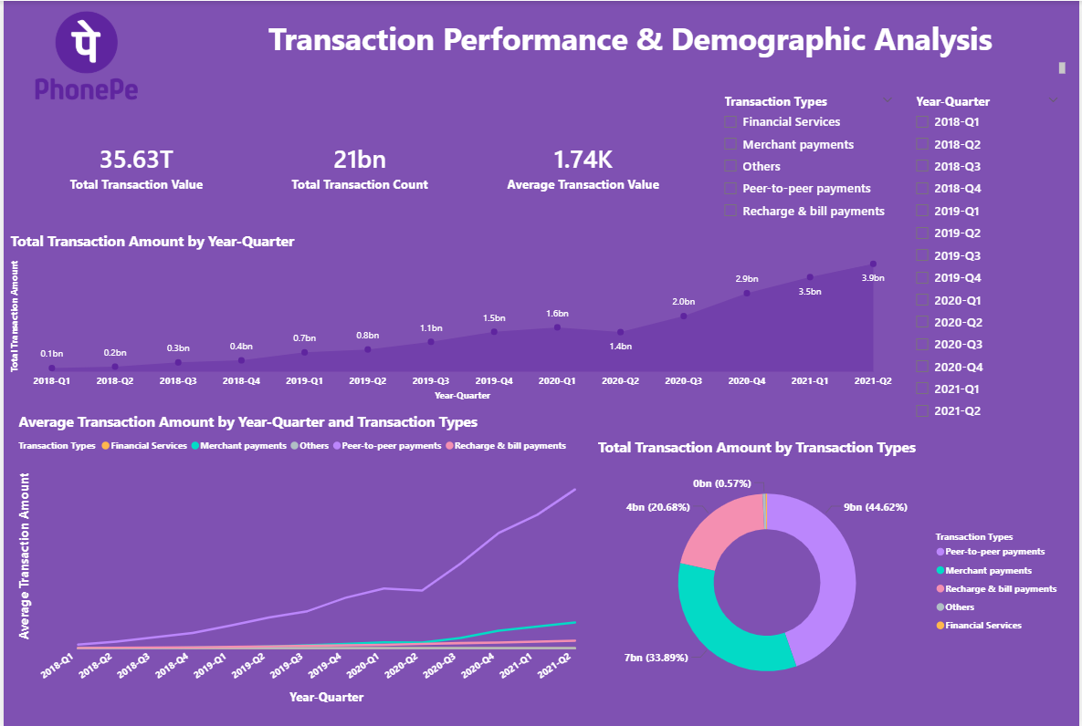
🖥️ Dashboard Overview (1) – Transaction Performance

Slide 11
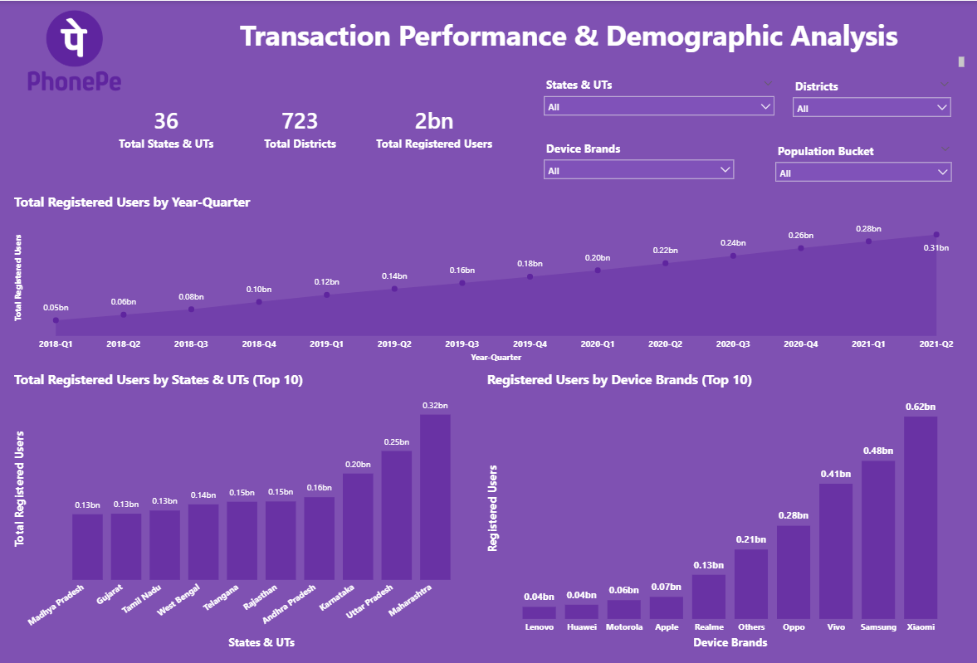
🖥️ Dashboard Overview (2) – Demographic Analysis

Slide 12
✅ Business Impact & Use Cases
Identify high-growth states for market expansion
Detect emerging states with strong quarter-on-quarter growth
Prioritize regions with increasing transaction value per user
Optimize marketing campaigns by dominant device segments
Align promotional strategies with high-adoption smartphone brands
Improve ROI through data-backed customer segmentation
Track category-wise transaction performance trends
Monitor growth of peer-to-peer vs merchant payments
Identify shifts in transaction mix over time
Support fintech investment decisions using state-level performance data
Identify high-value markets contributing most to national volume
Detect underpenetrated but fast-growing regions
Enable data-driven regional targeting
Understand geographic concentration of transaction activity
Guide localized product and partnership strategies

Slide 13
🙏 Acknowledgement & Contact
Project Analyst: Anik Chakraborty 📧 Email: anikc1710@gmail.com
Special Thanks To:
Coding Ninjas – for project framework and guidance
Connect: 🔗 GitHub | 🔗 LinkedIn

Slide 14
Thank You!

